Slide 1
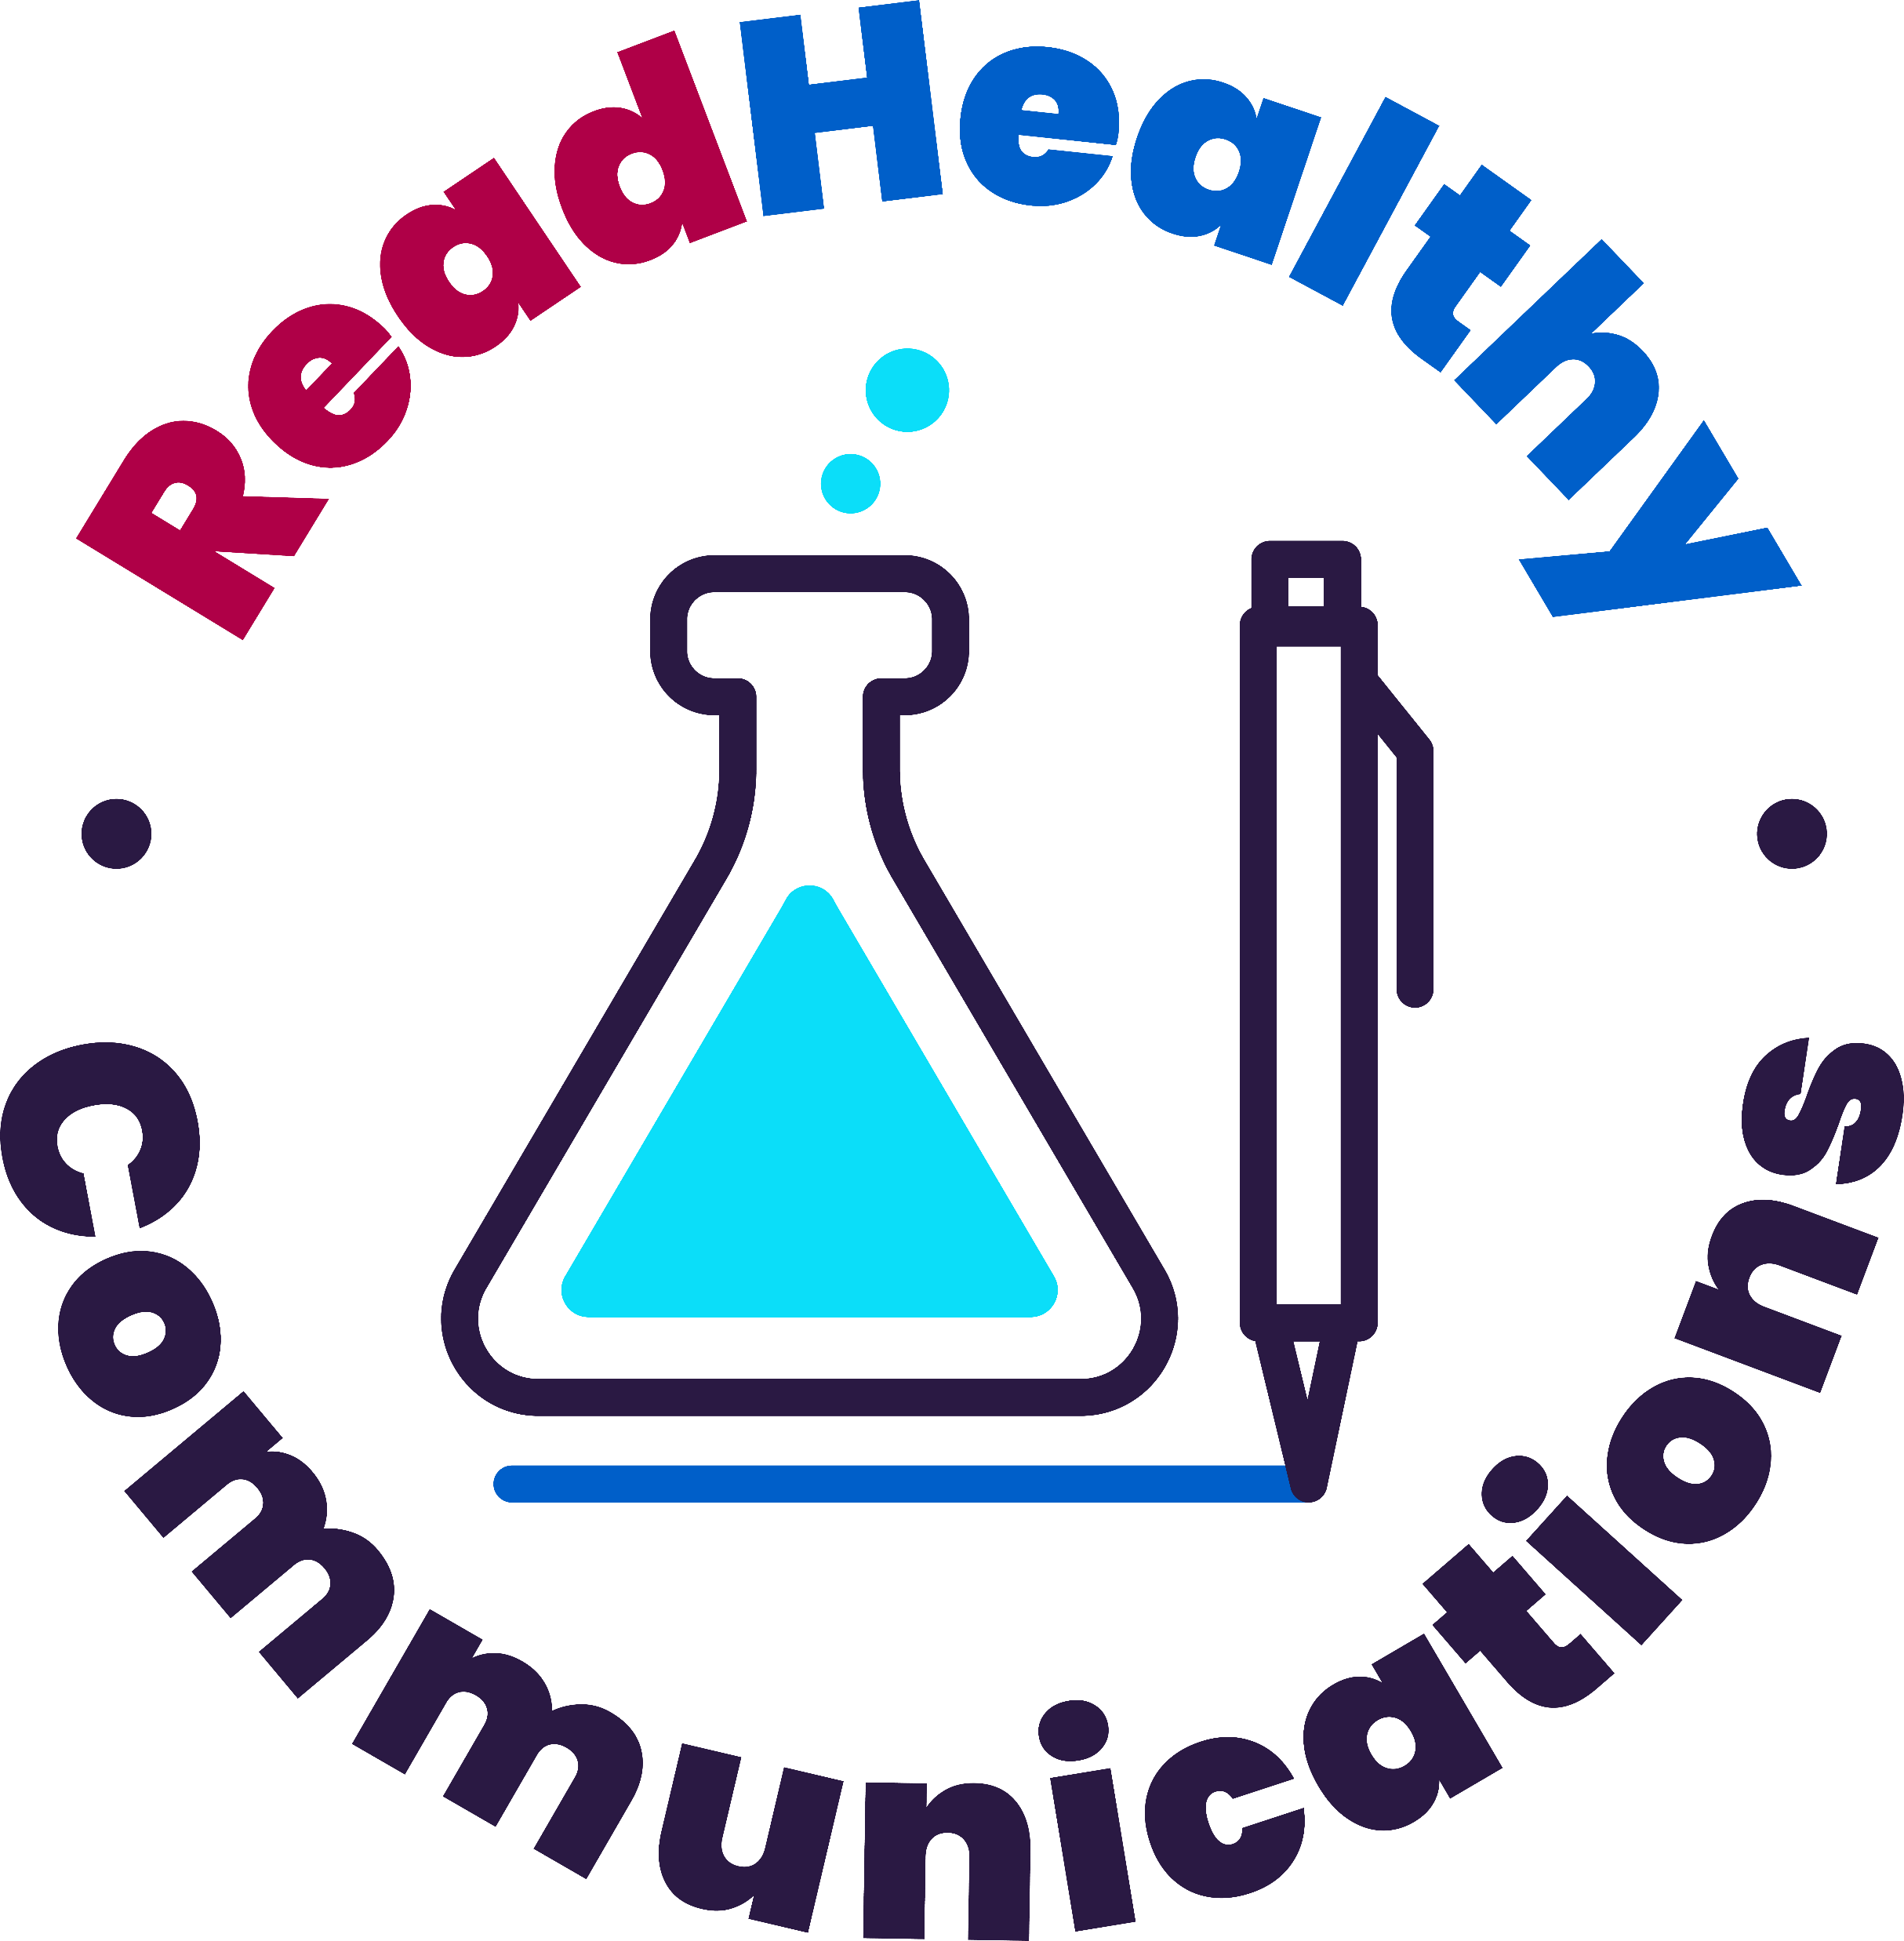
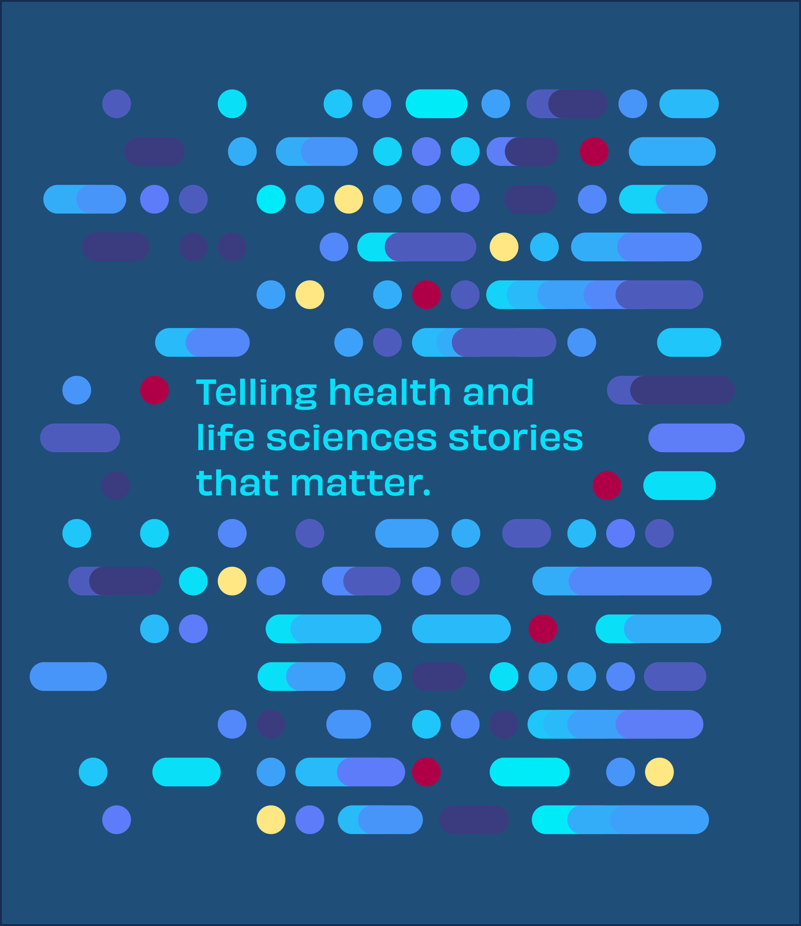
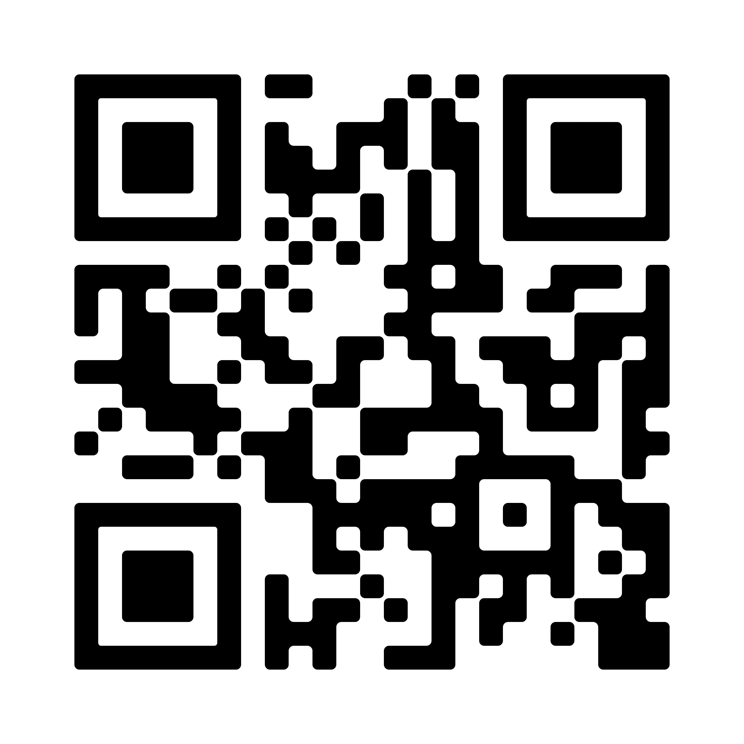
ReadHealthy Communications is a PR, communications, and storytelling firm that makes your health and science stories matter to the stakeholders that matter to you.
Who We Serve
Life Sciences
Med Device/Med Tech
Advocacy/Nonprofits
Services
Integrated communications
Corporate narratives
Brand positioning & messaging
Competitor messaging
Social media strategy & management
Audience research/personas
Media strategy Conferences/speaking ops Exec visibility/thought leadership Media outreach – trade/national Securing interview/byline ops Message maps, Q&As, talking points
Strategy & Planning
Media Relations
Press releases, regulatory/data news
Scientific writing
Web copy
Blogs/case studies
Bylines, op-eds
Social media content
Email marketing
Conference PPTs, talking points, speeches
Disease awareness/patient education
Marketing assets: white papers, fact sheets, infographics
Corporate decks
Storytelling & Content
Jennifer Ringler, MS
Owner, Founder
(973) 647-5004

