Slide 1

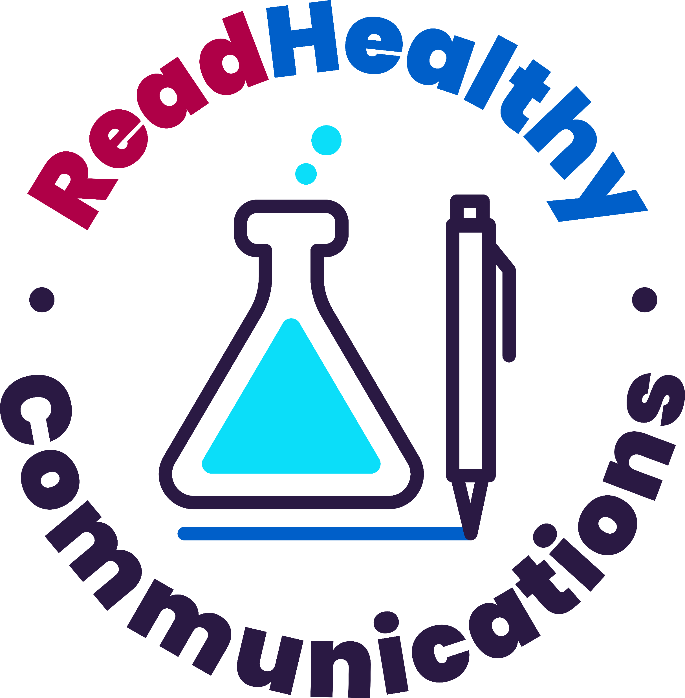
Proudly Partnering with Advocacy Orgs & Nonprofits.
Patient advocacy organizations and healthcare nonprofits are such an important part of the healthcare industry. Patient voices should
not be an afterthought.
But we know that nonprofit groups don’t have the funds to spend thousands of dollars per month on public relations and marketing to get the word out about what they do, develop content to educate patients, or get their news in front of the right reporters.
That’s why ReadHealthy Communications is proud to offer a discounted rate to patient advocacy organizations and nonprofit groups.
Because your stories matter.
Your stories are changing the world.
Reach out to ask about our discounted offerings.
Jennifer Ringler, Founder, Owner
jringler@readhealthy.net
ReadHealthy Communications is a woman-owned, disability-owned business. DE&I is in our DNA.
www.readhealthy.net

