Slide 1
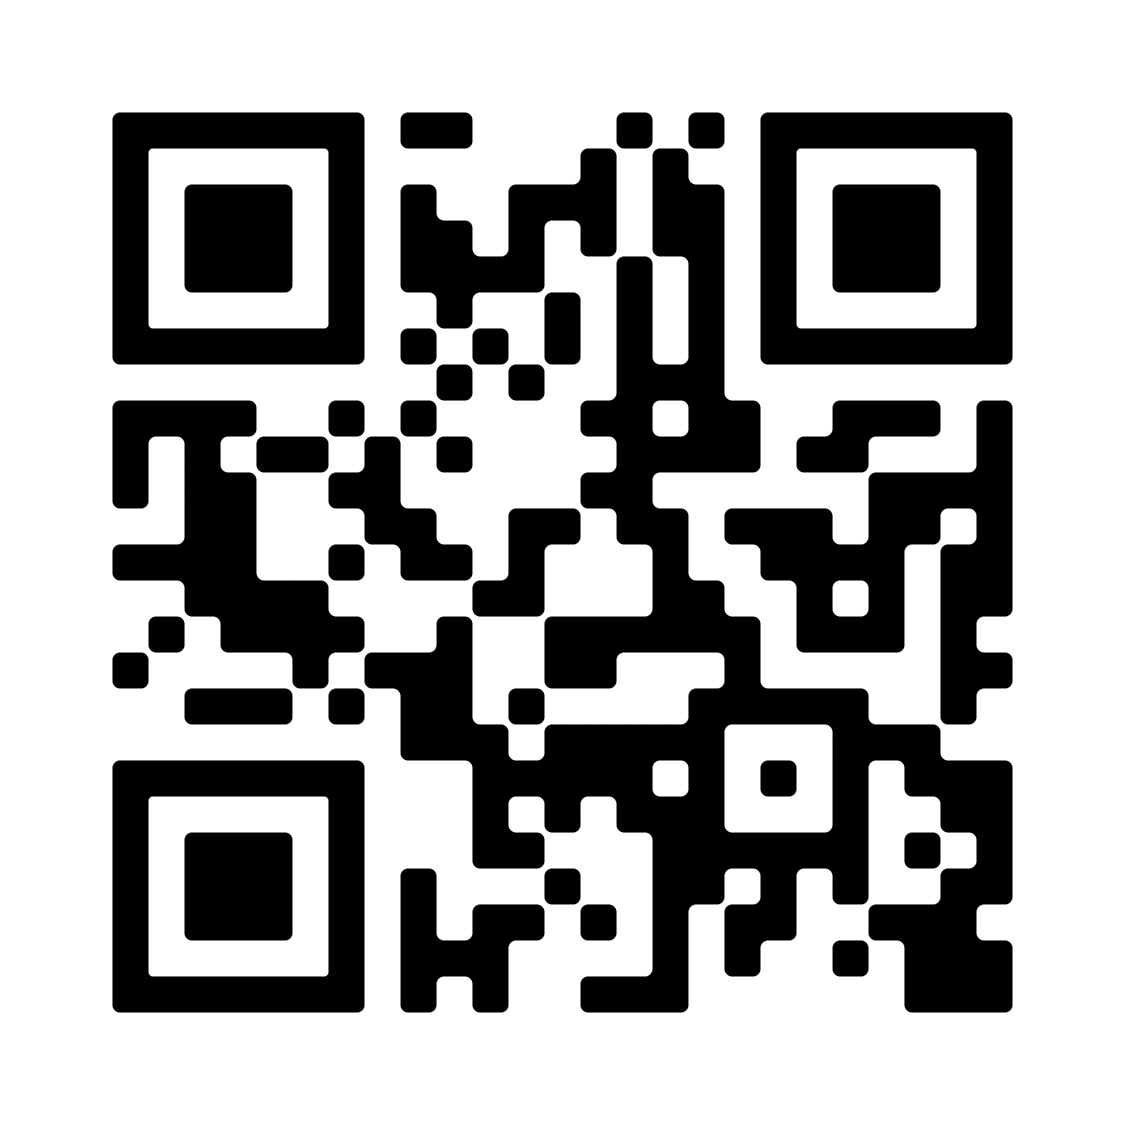
Five Questions to Help You Find Your Narrative
What is a corporate narrative? It’s your North Star, the “what” and “why” of what you do and how you help others. It’s the story that tells your raison d'être, and shares what makes your people, your mindset, and your vision special.
Once you have a strong corporate narrative in place, you can use that language to fuel all your content, from corporate blogs, to social media, to web copy, to bylines in industry publications. You can’t expect your audience to understand who you are until you understand it yourself.
Here are five questions to ask your leadership team to help you find and tell your story.
1. What do we offer?
Is it drug therapies? Medical devices? Patient education and resources? How about the deeper offer behind your product or service? Do you offer a sense of community for people with a certain health condition? Hope for a patient population with little or no treatment options? Efficiency or peace of mind for healthcare professionals? What do you really offer your target audience, beyond the “thing” you sell?
2. Who do we help?
Hint: The answer is not “everyone.” Really drill down and think about your audience. It is patients with a certain disease? Family and caregivers who need support and resources? Healthcare providers? Hospital executives? Whatever you think your target audience is, try breaking it down into three smaller subsets.
3. Does our audience understand us?
What do you think your target audience would say about you at a cocktail party? How far is that from what you’d want them to say about you? If your executives can’t boil down what it is you do, and for whom, into two sentences, your story is too complicated and you need to filter out the fluff.
4. What drives our people?
What makes your people special? What values really drive your employees? Is it curiosity, tenacity, persistence, grit, scrappiness, deep industry expertise? Is there a special sense of camaraderie or collaboration in how your people work together? A certain shared motivation or passion? Show your audiences the humanity beyond the product or service you offer.
5. Where are we going?
Ask each member of your leadership team to write down a hypothetical news headline they’d like to see about your company and its achievements one year from now, and another one they’d like to see five years from now. Compare notes and discuss. If there’s misalignment on what you want to achieve, your employees will be spinning their wheels and your potential customers will be confused.
To learn more about how to identify, solidify, and amplify your company’s story, reach out to schedule a call today. Email jringler@readhealthy.net.
Jennifer Ringler, MS
Owner, Founder
(973) 647-5004

